Slide 1
Software Code & Threat Analysis:
A CWE Group Project
Omar Salih, Ben Olson, Taylor Scott, Kyle Brinker

Slide 2

Steam
We chose Valve’s Steam source code for our software assurance target

Slide 3
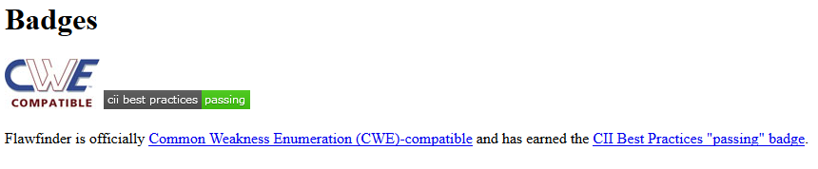
FLAWFINDER
We used Flawfinder to analyze the code for flaws

Slide 4
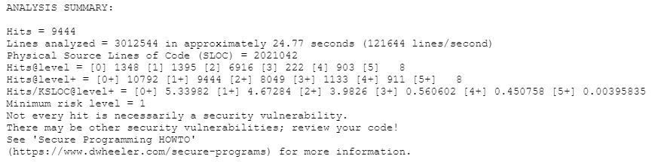
FLAWFINDER: Results
Flawfinder got 9444 hits in Steam’s code , all CWE’s no CVE’s
This is out of 2,021,042 lines of code
Not all hits are necessarily vulnerabilities and many were repeats

Slide 5
Selected CWE’s
CWE-362: Concurrent Execution using Shared Resource with Improper Synchronization ('Race Condition')
Medium likelihood of exploit, prevalent in C, C++, and Java languages
CWE-120: Does not check for buffer overflows when copying to destination
High likelihood of exploit, prevalent in C, C++ languages
CWE-134: If format strings can be influenced by an attacker, they can be exploited
High likelihood of exploit, prevalent in C, C++ languages

Slide 6
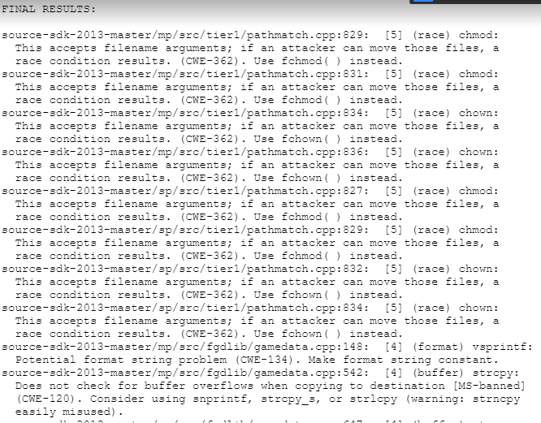
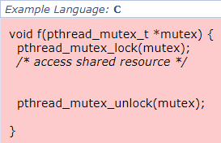
CWE 362
“The program contains a code sequence that can run concurrently with other code, and the code sequence requires temporary, exclusive access to a shared resource, but a timing window exists in which the shared resource can be modified by another code sequence that is operating concurrently. “
Notes:
Observed Examples
Reference & Description
CVE-2008-5044
Race condition leading to a crash by calling a hook removal procedure while other activities are occurring at the same time.
CVE-2008-2958
chain: time-of-check time-of-use (TOCTOU) race condition in program allows bypass of protection mechanism that was designed to prevent symlink attacks.
CVE-2008-1570
chain: time-of-check time-of-use (TOCTOU) race condition in program allows bypass of protection mechanism that was designed to prevent symlink attacks.
CVE-2008-0058
Unsynchronized caching operation enables a race condition that causes messages to be sent to a deallocated object.
CVE-2008-0379
Race condition during initialization triggers a buffer overflow.
CVE-2007-6599
Daemon crash by quickly performing operations and undoing them, which eventually leads to an operation that does not acquire a lock.
CVE-2007-6180
chain: race condition triggers NULL pointer dereference
CVE-2007-5794
Race condition in library function could cause data to be sent to the wrong process.
CVE-2007-3970
Race condition in file parser leads to heap corruption.
CVE-2008-5021
chain: race condition allows attacker to access an object while it is still being initialized, causing software to access uninitialized memory.
CVE-2009-4895
chain: race condition for an argument value, possibly resulting in NULL dereference
CVE-2009-3547
chain: race condition might allow resource to be released before operating on it, leading to NULL dereference
Example 1
This code could be used in an e-commerce application that supports transfers between accounts. It takes the total amount of the transfer, sends it to the new account, and deducts the amount from the original account.
Example 2
The following function attempts to acquire a lock in order to perform operations on a shared resource.
Potential Mitigations
Phase: Architecture and Design
In languages that support it, use synchronization primitives. Only wrap these around critical code to minimize the impact on performance.
Phase: Architecture and Design
Use thread-safe capabilities such as the data access abstraction in Spring.
Phase: Architecture and Design
Minimize the usage of shared resources in order to remove as much complexity as possible from the control flow and to reduce the likelihood of unexpected conditions occurring.
Additionally, this will minimize the amount of synchronization necessary and may even help to reduce the likelihood of a denial of service where an attacker may be able to repeatedly trigger a critical section (CWE-400).
Phase: Implementation
When using multithreading and operating on shared variables, only use thread-safe functions.
Phase: Implementation
Use atomic operations on shared variables. Be wary of innocent-looking constructs such as "x++". This may appear atomic at the code layer, but it is actually non-atomic at the instruction layer, since it involves a read, followed by a computation, followed by a write.
Phase: Implementation
Use a mutex if available, but be sure to avoid related weaknesses such as CWE-412.
Phase: Implementation
Avoid double-checked locking (CWE-609) and other implementation errors that arise when trying to avoid the overhead of synchronization.
Phase: Implementation
Disable interrupts or signals over critical parts of the code, but also make sure that the code does not go into a large or infinite loop.
Phase: Implementation
Use the volatile type modifier for critical variables to avoid unexpected compiler optimization or reordering. This does not necessarily solve the synchronization problem, but it can help.
Phases: Architecture and Design; Operation
Strategy: Environment Hardening
Run your code using the lowest privileges that are required to accomplish the necessary tasks [REF-76]. If possible, create isolated accounts with limited privileges that are only used for a single task. That way, a successful attack will not immediately give the attacker access to the rest of the software or its environment. For example, database applications rarely need to run as the database administrator, especially in day-to-day operations.

Slide 7
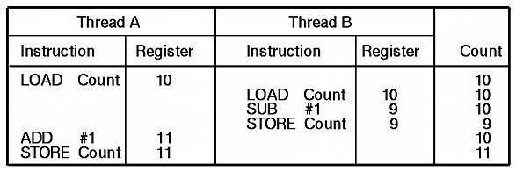
Race Condition Example

Slide 8
CWE 362 Consequences
When a race condition allows multiple control flows to access a resource simultaneously, it might lead the program into unexpected states, possibly resulting in a crash.
When a race condition is combined with predictable resource names and loose permissions, it may be possible for an attacker to overwrite or access confidential data.
Notes:
Likelihood Of Exploit
Medium
Scope & Impact of Consequences
Availability
Technical Impact: DoS: Resource Consumption (CPU); DoS: Resource Consumption (Memory); DoS: Resource Consumption (Other)
When a race condition makes it possible to bypass a resource cleanup routine or trigger multiple initialization routines, it may lead to resource exhaustion (CWE-400).
Availability
Technical Impact: DoS: Crash, Exit, or Restart; DoS: Instability
When a race condition allows multiple control flows to access a resource simultaneously, it might lead the program(s) into unexpected states, possibly resulting in a crash.
Confidentiality Integrity
Technical Impact: Read Files or Directories; Read Application Data
When a race condition is combined with predictable resource names and loose permissions, it may be possible for an attacker to overwrite or access confidential data (CWE-59).
Detection Methods
Black Box
Black box methods may be able to identify evidence of race conditions via methods such as multiple simultaneous connections, which may cause the software to become instable or crash. However, race conditions with very narrow timing windows would not be detectable.
White Box
Common idioms are detectable in white box analysis, such as time-of-check-time-of-use (TOCTOU) file operations (CWE-367), or double-checked locking (CWE-609).
Automated Dynamic Analysis
This weakness can be detected using dynamic tools and techniques that interact with the software using large test suites with many diverse inputs, such as fuzz testing (fuzzing), robustness testing, and fault injection. The software's operation may slow down, but it should not become unstable, crash, or generate incorrect results.
Race conditions may be detected with a stress-test by calling the software simultaneously from a large number of threads or processes, and look for evidence of any unexpected behavior.
Insert breakpoints or delays in between relevant code statements to artificially expand the race window so that it will be easier to detect.
Effectiveness: Moderate
Automated Static Analysis - Binary or Bytecode
According to SOAR, the following detection techniques may be useful:
Highly cost effective:
Bytecode Weakness Analysis - including disassembler + source code weakness analysis
Cost effective for partial coverage:
Binary Weakness Analysis - including disassembler + source code weakness analysis
Effectiveness: High
Dynamic Analysis with Automated Results Interpretation
According to SOAR, the following detection techniques may be useful:
Cost effective for partial coverage:
Web Application Scanner
Web Services Scanner
Database Scanners
Effectiveness: SOAR Partial
Dynamic Analysis with Manual Results Interpretation
According to SOAR, the following detection techniques may be useful:
Highly cost effective:
Framework-based Fuzzer
Cost effective for partial coverage:
Fuzz Tester
Monitored Virtual Environment - run potentially malicious code in sandbox / wrapper / virtual machine, see if it does anything suspicious
Effectiveness: High
Manual Static Analysis - Source Code
According to SOAR, the following detection techniques may be useful:
Highly cost effective:
Manual Source Code Review (not inspections)
Cost effective for partial coverage:
Focused Manual Spotcheck - Focused manual analysis of source
Effectiveness: High
Automated Static Analysis - Source Code
According to SOAR, the following detection techniques may be useful:
Highly cost effective:
Source code Weakness Analyzer
Context-configured Source Code Weakness Analyzer
Effectiveness: High
Architecture or Design Review
According to SOAR, the following detection techniques may be useful:
Highly cost effective:
Formal Methods / Correct-By-Construction
Cost effective for partial coverage:
Inspection (IEEE 1028 standard) (can apply to requirements, design, source code, etc.)
Effectiveness: High
Detection Methods

Slide 9
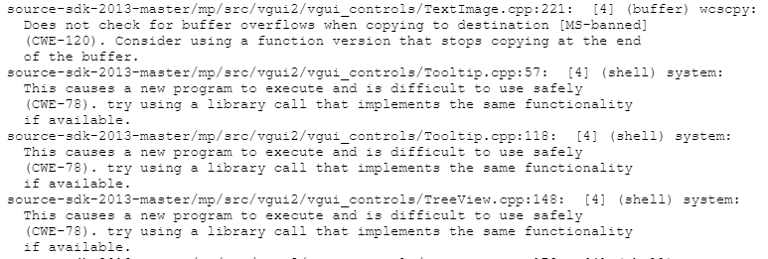

CWE 120
The program copies an input buffer to an output buffer without verifying that the size of the input buffer is less than the size of the output buffer, leading to a buffer overflow.
Notes:
Affected Resources Memory
Functional Areas Memory Management
Extended Description
A buffer overflow condition exists when a program attempts to put more data in a buffer than it can hold, or when a program attempts to put data in a memory area outside of the boundaries of a buffer. The simplest type of error, and the most common cause of buffer overflows, is the "classic" case in which the program copies the buffer without restricting how much is copied. Other variants exist, but the existence of a classic overflow strongly suggests that the programmer is not considering even the most basic of security protections.
Modes Of Introduction
The different Modes of Introduction provide information about how and when this weakness may be introduced. The Phase identifies a point in the software life cycle at which introduction may occur, while the Note provides a typical scenario related to introduction during the given phase.
Phase: Implementation
Potential Mitigations
Phase: Requirements
Strategy: Language Selection
Use a language that does not allow this weakness to occur or provides constructs that make this weakness easier to avoid.
For example, many languages that perform their own memory management, such as Java and Perl, are not subject to buffer overflows. Other languages, such as Ada and C#, typically provide overflow protection, but the protection can be disabled by the programmer.
Be wary that a language's interface to native code may still be subject to overflows, even if the language itself is theoretically safe.
Phase: Architecture and Design
Strategy: Libraries or Frameworks
Use a vetted library or framework that does not allow this weakness to occur or provides constructs that make this weakness easier to avoid.
Examples include the Safe C String Library (SafeStr) by Messier and Viega [REF-57], and the Strsafe.h library from Microsoft [REF-56]. These libraries provide safer versions of overflow-prone string-handling functions.
Note: This is not a complete solution, since many buffer overflows are not related to strings.
Phase: Build and Compilation
Strategy: Compilation or Build Hardening
Run or compile the software using features or extensions that automatically provide a protection mechanism that mitigates or eliminates buffer overflows.
For example, certain compilers and extensions provide automatic buffer overflow detection mechanisms that are built into the compiled code. Examples include the Microsoft Visual Studio /GS flag, Fedora/Red Hat FORTIFY_SOURCE GCC flag, StackGuard, and ProPolice.
Effectiveness: Defense in Depth
Note: This is not necessarily a complete solution, since these mechanisms can only detect certain types of overflows. In addition, an attack could still cause a denial of service, since the typical response is to exit the application.
Phase: Implementation
Consider adhering to the following rules when allocating and managing an application's memory:
Double check that your buffer is as large as you specify.
When using functions that accept a number of bytes to copy, such as strncpy(), be aware that if the destination buffer size is equal to the source buffer size, it may not NULL-terminate the string.
Check buffer boundaries if accessing the buffer in a loop and make sure you are not in danger of writing past the allocated space.
If necessary, truncate all input strings to a reasonable length before passing them to the copy and concatenation functions.
Phase: Implementation
Strategy: Input Validation
Assume all input is malicious. Use an "accept known good" input validation strategy, i.e., use a whitelist of acceptable inputs that strictly conform to specifications. Reject any input that does not strictly conform to specifications, or transform it into something that does.
When performing input validation, consider all potentially relevant properties, including length, type of input, the full range of acceptable values, missing or extra inputs, syntax, consistency across related fields, and conformance to business rules. As an example of business rule logic, "boat" may be syntactically valid because it only contains alphanumeric characters, but it is not valid if the input is only expected to contain colors such as "red" or "blue."
Do not rely exclusively on looking for malicious or malformed inputs (i.e., do not rely on a blacklist). A blacklist is likely to miss at least one undesirable input, especially if the code's environment changes. This can give attackers enough room to bypass the intended validation. However, blacklists can be useful for detecting potential attacks or determining which inputs are so malformed that they should be rejected outright.
Phase: Architecture and Design
For any security checks that are performed on the client side, ensure that these checks are duplicated on the server side, in order to avoid CWE-602. Attackers can bypass the client-side checks by modifying values after the checks have been performed, or by changing the client to remove the client-side checks entirely. Then, these modified values would be submitted to the server.
Phase: Operation
Strategy: Environment Hardening
Run or compile the software using features or extensions that randomly arrange the positions of a program's executable and libraries in memory. Because this makes the addresses unpredictable, it can prevent an attacker from reliably jumping to exploitable code.
Examples include Address Space Layout Randomization (ASLR) [REF-58] [REF-60] and Position-Independent Executables (PIE) [REF-64].
Effectiveness: Defense in Depth
Note: This is not a complete solution. However, it forces the attacker to guess an unknown value that changes every program execution. In addition, an attack could still cause a denial of service, since the typical response is to exit the application.
Phase: Operation
Strategy: Environment Hardening
Use a CPU and operating system that offers Data Execution Protection (NX) or its equivalent [REF-60] [REF-61].
Effectiveness: Defense in Depth
Note: This is not a complete solution, since buffer overflows could be used to overwrite nearby variables to modify the software's state in dangerous ways. In addition, it cannot be used in cases in which self-modifying code is required. Finally, an attack could still cause a denial of service, since the typical response is to exit the application.
Phases: Build and Compilation; Operation
Most mitigating technologies at the compiler or OS level to date address only a subset of buffer overflow problems and rarely provide complete protection against even that subset. It is good practice to implement strategies to increase the workload of an attacker, such as leaving the attacker to guess an unknown value that changes every program execution.
Phase: Implementation
Replace unbounded copy functions with analogous functions that support length arguments, such as strcpy with strncpy. Create these if they are not available.
Effectiveness: Moderate
Note: This approach is still susceptible to calculation errors, including issues such as off-by-one errors (CWE-193) and incorrectly calculating buffer lengths (CWE-131).
Phase: Architecture and Design
Strategy: Enforcement by Conversion
When the set of acceptable objects, such as filenames or URLs, is limited or known, create a mapping from a set of fixed input values (such as numeric IDs) to the actual filenames or URLs, and reject all other inputs.
Phases: Architecture and Design; Operation
Strategy: Environment Hardening
Run your code using the lowest privileges that are required to accomplish the necessary tasks [REF-76]. If possible, create isolated accounts with limited privileges that are only used for a single task. That way, a successful attack will not immediately give the attacker access to the rest of the software or its environment. For example, database applications rarely need to run as the database administrator, especially in day-to-day operations.
Phases: Architecture and Design; Operation
Strategy: Sandbox or Jail
Run the code in a "jail" or similar sandbox environment that enforces strict boundaries between the process and the operating system. This may effectively restrict which files can be accessed in a particular directory or which commands can be executed by the software.
OS-level examples include the Unix chroot jail, AppArmor, and SELinux. In general, managed code may provide some protection. For example, java.io.FilePermission in the Java SecurityManager allows the software to specify restrictions on file operations.
This may not be a feasible solution, and it only limits the impact to the operating system; the rest of the application may still be subject to compromise.
Be careful to avoid CWE-243 and other weaknesses related to jails.
Effectiveness: Limited
Note: The effectiveness of this mitigation depends on the prevention capabilities of the specific sandbox or jail being used and might only help to reduce the scope of an attack, such as restricting the attacker to certain system calls or limiting the portion of the file system that can be accessed.
Detection Methods
Automated Static Analysis
This weakness can often be detected using automated static analysis tools. Many modern tools use data flow analysis or constraint-based techniques to minimize the number of false positives.
Automated static analysis generally does not account for environmental considerations when reporting out-of-bounds memory operations. This can make it difficult for users to determine which warnings should be investigated first. For example, an analysis tool might report buffer overflows that originate from command line arguments in a program that is not expected to run with setuid or other special privileges.
Effectiveness: High
Note: Detection techniques for buffer-related errors are more mature than for most other weakness types.
Automated Dynamic Analysis
This weakness can be detected using dynamic tools and techniques that interact with the software using large test suites with many diverse inputs, such as fuzz testing (fuzzing), robustness testing, and fault injection. The software's operation may slow down, but it should not become unstable, crash, or generate incorrect results.
Manual Analysis
Manual analysis can be useful for finding this weakness, but it might not achieve desired code coverage within limited time constraints. This becomes difficult for weaknesses that must be considered for all inputs, since the attack surface can be too large.
Automated Static Analysis - Binary or Bytecode
According to SOAR, the following detection techniques may be useful:
Highly cost effective:
Bytecode Weakness Analysis - including disassembler + source code weakness analysis
Binary Weakness Analysis - including disassembler + source code weakness analysis
Effectiveness: High
Manual Static Analysis - Binary or Bytecode
According to SOAR, the following detection techniques may be useful:
Cost effective for partial coverage:
Binary / Bytecode disassembler - then use manual analysis for vulnerabilities & anomalies
Effectiveness: SOAR Partial
Dynamic Analysis with Automated Results Interpretation
According to SOAR, the following detection techniques may be useful:
Cost effective for partial coverage:
Web Application Scanner
Web Services Scanner
Database Scanners
Effectiveness: SOAR Partial
Dynamic Analysis with Manual Results Interpretation
According to SOAR, the following detection techniques may be useful:
Cost effective for partial coverage:
Fuzz Tester
Framework-based Fuzzer
Effectiveness: SOAR Partial
Manual Static Analysis - Source Code
According to SOAR, the following detection techniques may be useful:
Cost effective for partial coverage:
Focused Manual Spotcheck - Focused manual analysis of source
Manual Source Code Review (not inspections)
Effectiveness: SOAR Partial
Automated Static Analysis - Source Code
According to SOAR, the following detection techniques may be useful:
Highly cost effective:
Source code Weakness Analyzer
Context-configured Source Code Weakness Analyzer
Effectiveness: High
Architecture or Design Review
According to SOAR, the following detection techniques may be useful:
Highly cost effective:
Formal Methods / Correct-By-Construction
Cost effective for partial coverage:
Inspection (IEEE 1028 standard) (can apply to requirements, design, source code, etc.)
Effectiveness: High
Alternate Terms
buffer overrun:
Some prominent vendors and researchers use the term "buffer overrun," but most people use "buffer overflow."
Unbounded Transfer

Slide 10
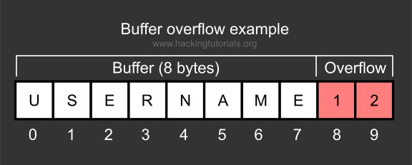
Buffer Overflow Example

Slide 11
CWE 120 Consequences
Buffer overflows often can be used to execute arbitrary code, which is usually outside the scope of a program's implicit security policy. This can often be used to subvert any other security service.
Buffer overflows generally lead to crashes. Other attacks leading to lack of availability are possible, including putting the program into an infinite loop.
Notes:
Likelihood Of Exploit High
Common Consequences
The table below specifies different individual consequences associated with the weakness. The Scope identifies the application security area that is violated, while the Impact describes the negative technical impact that arises if an adversary succeeds in exploiting this weakness. The Likelihood provides information about how likely the specific consequence is expected to be seen relative to the other consequences in the list. For example, there may be high likelihood that a weakness will be exploited to achieve a certain impact, but a low likelihood that it will be exploited to achieve a different impact.
Scope & Impact of Consequence
Integrity
Confidentiality
Availability
Technical Impact: Execute Unauthorized Code or Commands
Buffer overflows often can be used to execute arbitrary code, which is usually outside the scope of a program's implicit security policy. This can often be used to subvert any other security service.
Availability
Technical Impact: DoS: Crash, Exit, or Restart; DoS: Resource Consumption (CPU)
Buffer overflows generally lead to crashes. Other attacks leading to lack of availability are possible, including putting the program into an infinite loop.
Observed Examples
Reference & Description
CVE-2000-1094
buffer overflow using command with long argument
CVE-1999-0046
buffer overflow in local program using long environment variable
CVE-2002-1337
buffer overflow in comment characters, when product increments a counter for a ">" but does not decrement for "<"
CVE-2003-0595
By replacing a valid cookie value with an extremely long string of characters, an attacker may overflow the application's buffers.
CVE-2001-0191
By replacing a valid cookie value with an extremely long string of characters, an attacker may overflow the application's buffers.

Slide 12
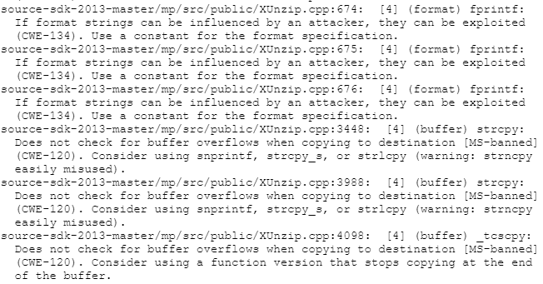
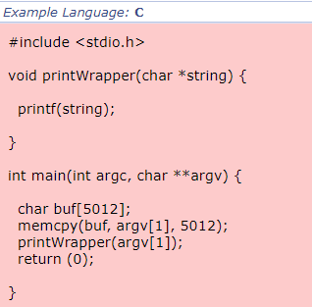
CWE 134
The software uses a function that accepts a format string as an argument, but the format string originates from an external source.
Notes:
Extended Description
When an attacker can modify an externally-controlled format string, this can lead to buffer overflows, denial of service, or data representation problems.
It should be noted that in some circumstances, such as internationalization, the set of format strings is externally controlled by design. If the source of these format strings is trusted (e.g. only contained in library files that are only modifiable by the system administrator), then the external control might not itself pose a vulnerability.
Modes Of Introduction
The different Modes of Introduction provide information about how and when this weakness may be introduced. The Phase identifies a point in the software life cycle at which introduction may occur, while the Note provides a typical scenario related to introduction during the given phase.
Phase & Notes
Implementation
The programmer rarely intends for a format string to be externally-controlled at all. This weakness is frequently introduced in code that constructs log messages, where a constant format string is omitted.
Implementation
In cases such as localization and internationalization, the language-specific message repositories could be an avenue for exploitation, but the format string issue would be resultant, since attacker control of those repositories would also allow modification of message length, format, and content.

Slide 13
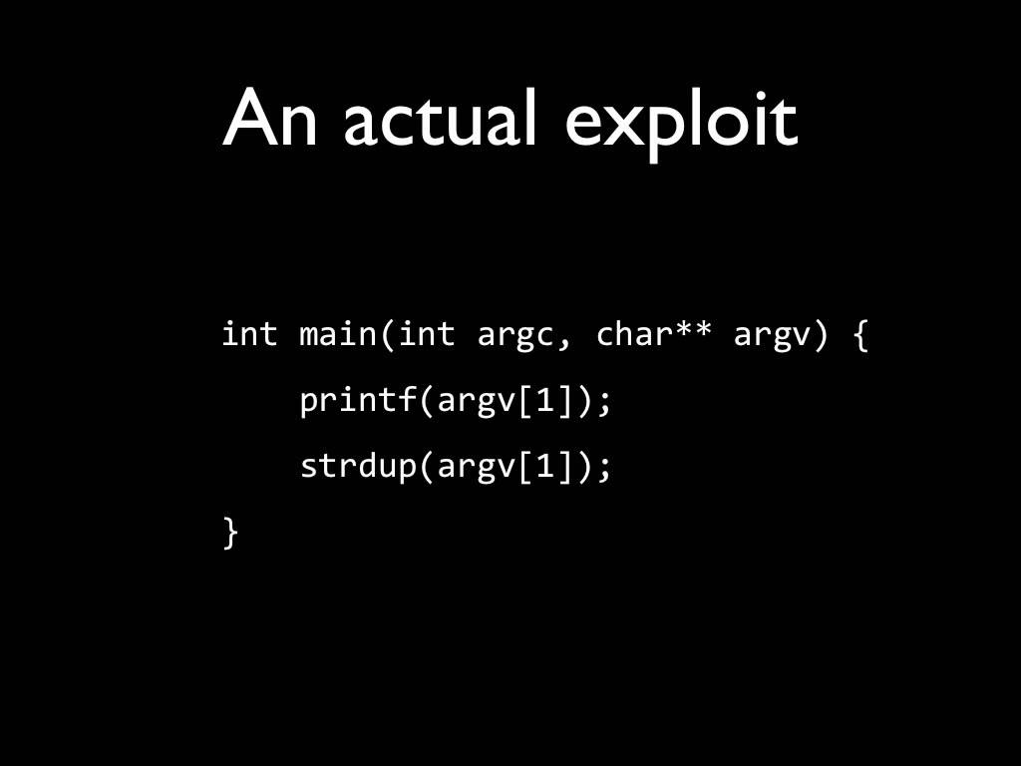
Format String Attack Example

Slide 14
CWE 134 Consequences
When an attacker can modify an externally-controlled format string, this can lead to buffer overflows, denial of service, or data representation problems.
It should be noted that in some circumstances, such as internationalization, the set of format strings is externally controlled by design. If the source of these format strings is trusted then the external control might not itself pose a vulnerability.
Notes:
Affected Resources Memory
Functional Areas
Logging
Error Handling
String Processing
Likelihood Of Exploit High
Common Consequences
The table below specifies different individual consequences associated with the weakness. The Scope identifies the application security area that is violated, while the Impact describes the negative technical impact that arises if an adversary succeeds in exploiting this weakness. The Likelihood provides information about how likely the specific consequence is expected to be seen relative to the other consequences in the list. For example, there may be high likelihood that a weakness will be exploited to achieve a certain impact, but a low likelihood that it will be exploited to achieve a different impact.
Scope & Impact
Confidentiality
Technical Impact: Read Memory
Format string problems allow for information disclosure which can severely simplify exploitation of the program.
Integrity
Confidentiality
Availability
Technical Impact: Execute Unauthorized Code or Commands
Format string problems can result in the execution of arbitrary code.
Observed Examples
Reference & Description
CVE-2002-1825
format string in Perl program
CVE-2001-0717
format string in bad call to syslog function
CVE-2002-0573
format string in bad call to syslog function
CVE-2002-1788
format strings in NNTP server responses
CVE-2006-2480
Format string vulnerability exploited by triggering errors or warnings, as demonstrated via format string specifiers in a .bmp filename.
CVE-2007-2027
Chain: untrusted search path enabling resultant format string by loading malicious internationalization messages

Slide 15
CWE 134: Mitigation
Choose a language that is not subject to this flaw.
Ensure that all format string functions are passed a static string which cannot be controlled by the user and that the proper number of arguments are always sent to that function as well.
Heed the warnings of compilers and linkers, since they may alert you to improper usage.
Notes:
Potential CWE-134 Mitigations
Phase: Requirements
Choose a language that is not subject to this flaw.
Phase: Implementation
Ensure that all format string functions are passed a static string which cannot be controlled by the user and that the proper number of arguments are always sent to that function as well. If at all possible, use functions that do not support the %n operator in format strings. [REF-116] [REF-117]
Phase: Build and Compilation
Heed the warnings of compilers and linkers, since they may alert you to improper usage.
Related Attack Patterns
CAPEC-ID & Attack Pattern Name
CAPEC-135
Format String Injection
CAPEC-67
String Format Overflow in syslog()
Detection Methods
Automated Static Analysis
This weakness can often be detected using automated static analysis tools. Many modern tools use data flow analysis or constraint-based techniques to minimize the number of false positives.
Black Box
Since format strings often occur in rarely-occurring erroneous conditions (e.g. for error message logging), they can be difficult to detect using black box methods. It is highly likely that many latent issues exist in executables that do not have associated source code (or equivalent source.
Effectiveness: Limited
Automated Static Analysis - Binary or Bytecode
According to SOAR, the following detection techniques may be useful:
Highly cost effective:
Bytecode Weakness Analysis - including disassembler + source code weakness analysis
Binary Weakness Analysis - including disassembler + source code weakness analysis
Cost effective for partial coverage:
Binary / Bytecode simple extractor – strings, ELF readers, etc.
Effectiveness: High
Manual Static Analysis - Binary or Bytecode
According to SOAR, the following detection techniques may be useful:
Cost effective for partial coverage:
Binary / Bytecode disassembler - then use manual analysis for vulnerabilities & anomalies
Effectiveness: SOAR Partial
Dynamic Analysis with Automated Results Interpretation
According to SOAR, the following detection techniques may be useful:
Cost effective for partial coverage:
Web Application Scanner
Web Services Scanner
Database Scanners
Effectiveness: SOAR Partial
Dynamic Analysis with Manual Results Interpretation
According to SOAR, the following detection techniques may be useful:
Cost effective for partial coverage:
Fuzz Tester
Framework-based Fuzzer
Effectiveness: SOAR Partial
Manual Static Analysis - Source Code
According to SOAR, the following detection techniques may be useful:
Highly cost effective:
Manual Source Code Review (not inspections)
Cost effective for partial coverage:
Focused Manual Spotcheck - Focused manual analysis of source
Effectiveness: High
Automated Static Analysis - Source Code
According to SOAR, the following detection techniques may be useful:
Highly cost effective:
Source code Weakness Analyzer
Context-configured Source Code Weakness Analyzer
Cost effective for partial coverage:
Warning Flags
Effectiveness: High
Architecture or Design Review
According to SOAR, the following detection techniques may be useful:
Highly cost effective:
Formal Methods / Correct-By-Construction
Cost effective for partial coverage:
Inspection (IEEE 1028 standard) (can apply to requirements, design, source code, etc.)
Effectiveness: High

Slide 16
CONCLUSION
Everything has a vulnerability, weakness, or bug that can be exploited.
BE CAREFUL WITH WHAT YOU DO!!!!!!!!!!

Slide 17

Notes:
Questions?

Slide 18

Notes:
The End

